Slide 1
Order Management of E-Commerce Business

Slide 2
Business Processes
Order Placement
Order Fulfillment and Shipment
Invoicing
Exchange & Returns
Customer Review/Feedback

Slide 3
Business Matrix
 | Products | Customers | Location | Date | Order Status | Payments | Returns
Order Placement |  | X | X | X
Order Fulfilment |  | X | X | X | X
Invoicing | X | X | X | X |  | X
Exchange | X | X | X
Returns | X | X | X |  |  |  | X
Customer Review/Feedback | X | X | X | X
Dataset: Brazilian E-Commerce Public Dataset by Olist (kaggle.com)

Slide 4
Business Process 1: Order Placement
Objectives:
Utilizing order placement data enables us to analyze the seasonal trends in customer purchasing behavior, we can devise strategies to optimize sales performance across all seasons.
By leveraging order placement data, we can identify opportunities to enhance sales in specific geographic locations through the introduction of related products tailored to the preferences and needs of local customers.

Slide 5
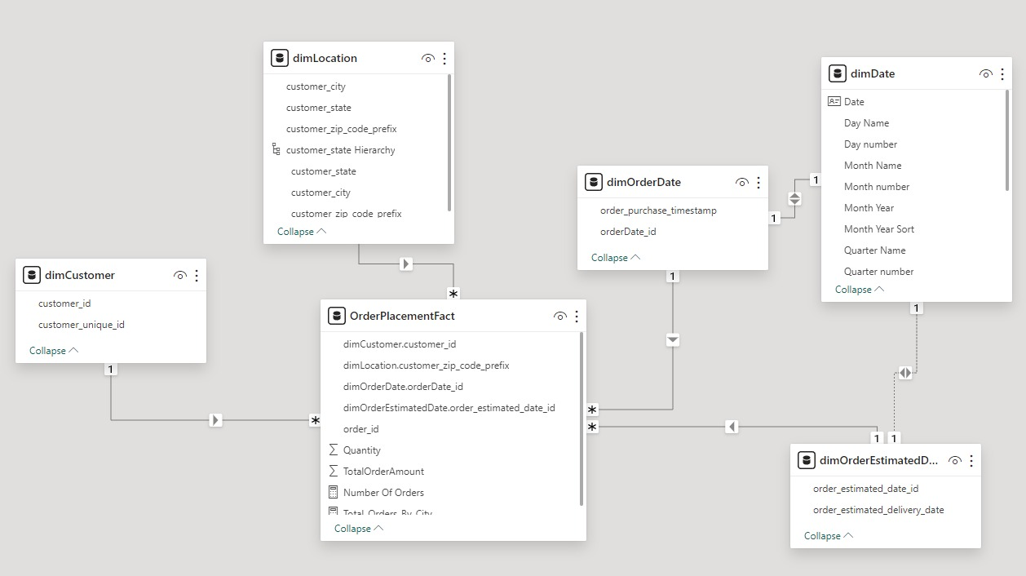
Data Model
Fact Table Type: Transactional
Degenerative Dimension: Order_ID
Dimensions:
Customer (Conformed)
Location (Conformed)
Order Estimated Delivery Date (Role-Playing)
Order Date(Role Playing)
Date(Role Playing)

Slide 6
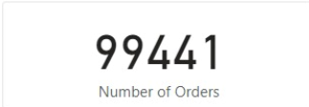

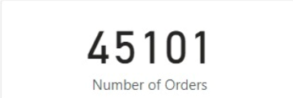
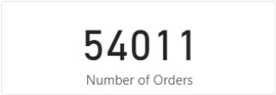
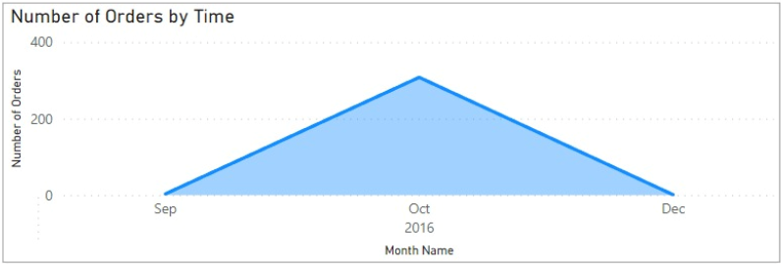
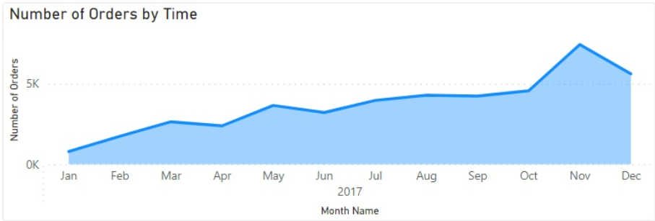
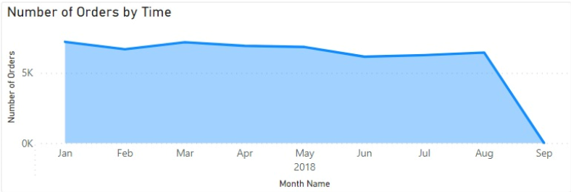
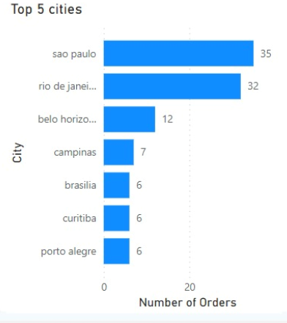
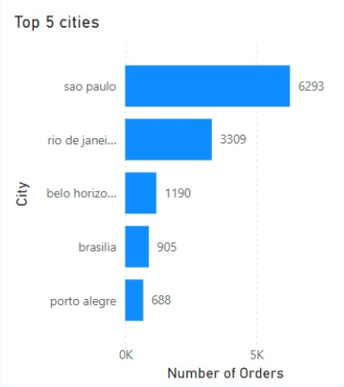
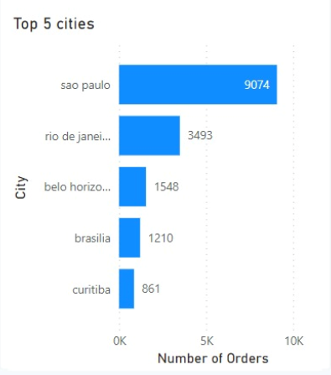
Analysis and Outcomes/Learnings
Total
Total Oder Placed: 99441
From 2017-2018: 19.72%(Realistic) increase in orders
Highest orders from Sao Paulo throughout 3 years.
Year
2018
2016
2017

Slide 7
Business Process 2: Order Fulfillment and Shipment
Objective:
This Business Process tracks a particular order through its journey from Placement to final delivery.
The order goes through various statuses such as approved, shipped, delivered, invoiced, cancelled or unavailable.
Problem Statement:
What number/Percentage of orders are delivered to customer?
How much average time does it take for an order to reach the customer since placed?
What are the number of orders that were delivered later than the estimated date?

Slide 8
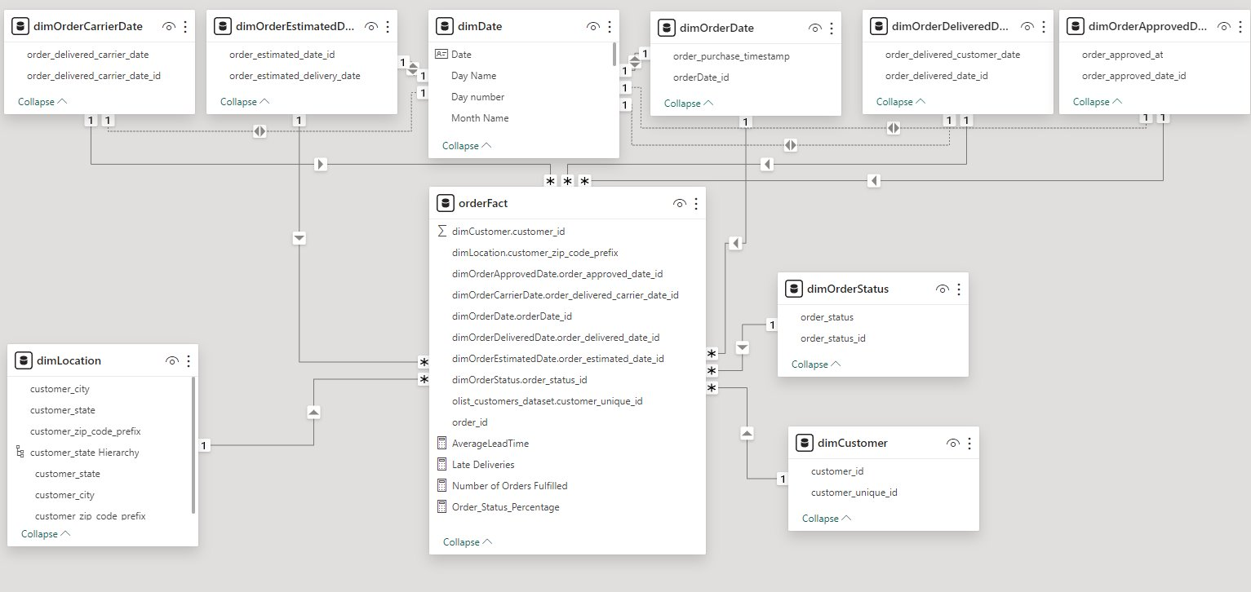
Data Model
Fact Table – Transactional
Role-Playing Dimensions
dimOrderDate
dimOrderApprovedDate
dimOrderCarrierDate
dimOrderDeliveredDate
Conformed Dimension
dimLocation
dimCustomer
Degenerate Dimension
order_id

Slide 9
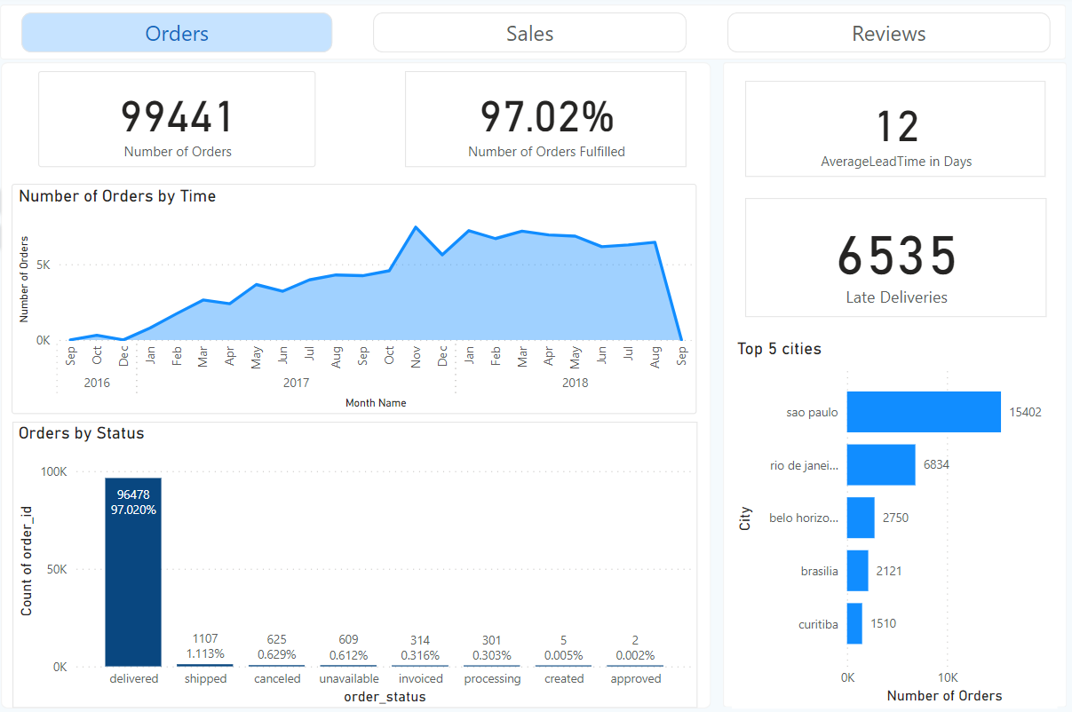
Analysis and Outcomes/Learnings
Overall

Slide 10
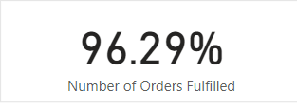
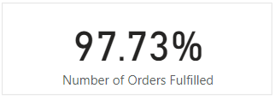
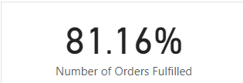

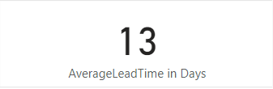
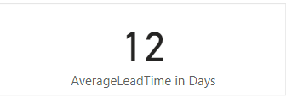

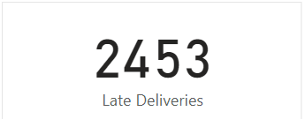
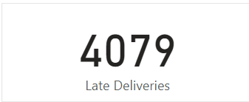
Analysis and Outcomes/Learnings
Year
2017
2018
2016
2017
2018
2016

Slide 11
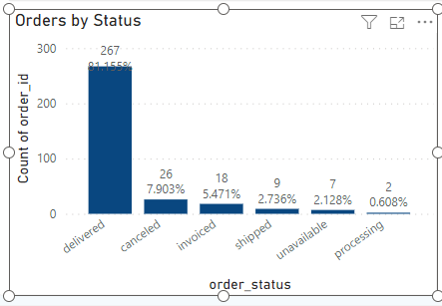
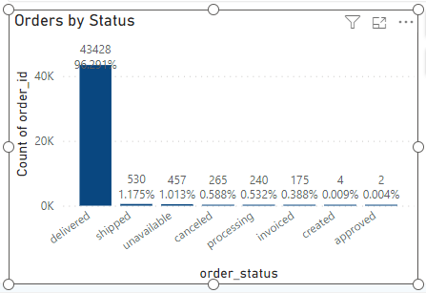
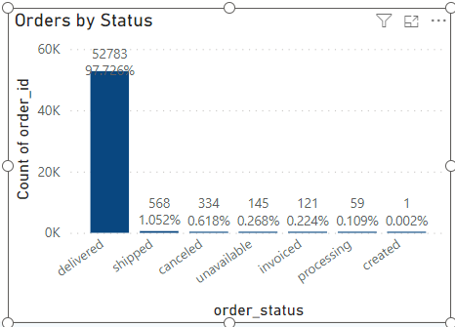

Analysis and Outcomes/Learnings
Year
2016
2017
2018
2016
2017
2018

Slide 12
Analysis and Outcomes/Learnings
Even though the number of late deliveries are increasing, the average lead time for the order in decreasing every year.
The percentage of cancelled orders are decreasing, however, for each year, the number of cancelled orders are increasing steadily. This is an area of concern where the business can improve.
The unavailability of orders is a huge concern as well where in 2017, the number of unavailable orders shot up to 457.

Slide 13
Business Process 3: Invoicing
Objective:
Enhancing the ability of E-Commerce invoicing process to better understand financial accuracy, record keeping & a deeper analysis of sales to streamline operations
This process involves recordkeeping of the invoices to customers for products purchased, tracking of sales through these invoices.

Slide 14
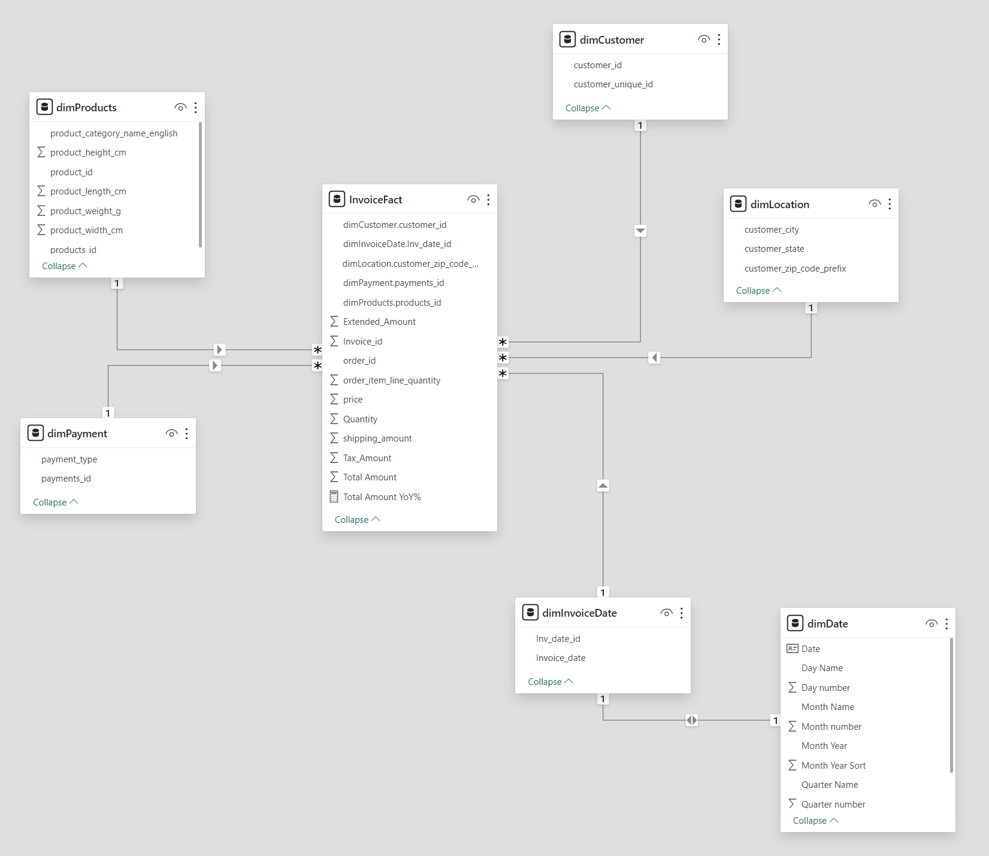
Data Model
Fact Table. Type: Transactional
Dimensions:
Products (Conformed)
Customer (Conformed)
Location (Conformed)
Payment
Invoice Date (Role-Playing)
Invoice_id (Degenerate Dim)

Slide 15
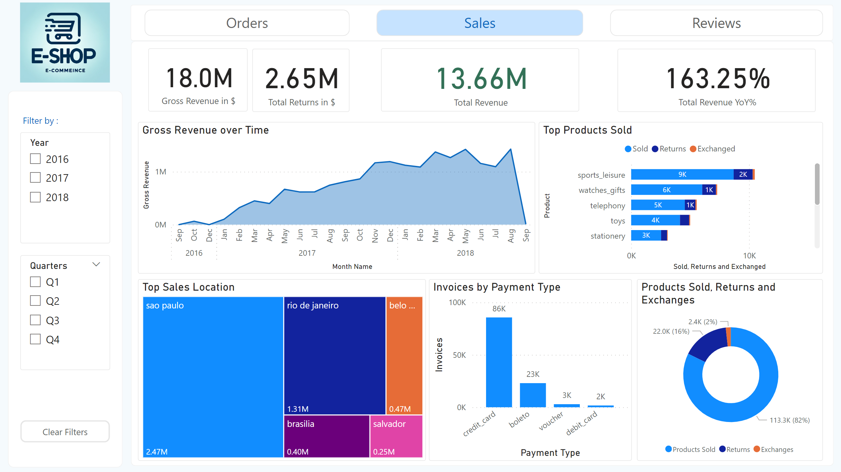
Analysis
Overall Insights based on the invoices:
Over the span of 2 Years, Total Revenue was 13.66M from over 113K Products Sold.
Most sold products were Sports, Watches, Telephony and Toys
Most orders are placed from customers residing in Sao Paulo, Rio de Janeiro
Credit card is the most common used method of payment

Slide 16
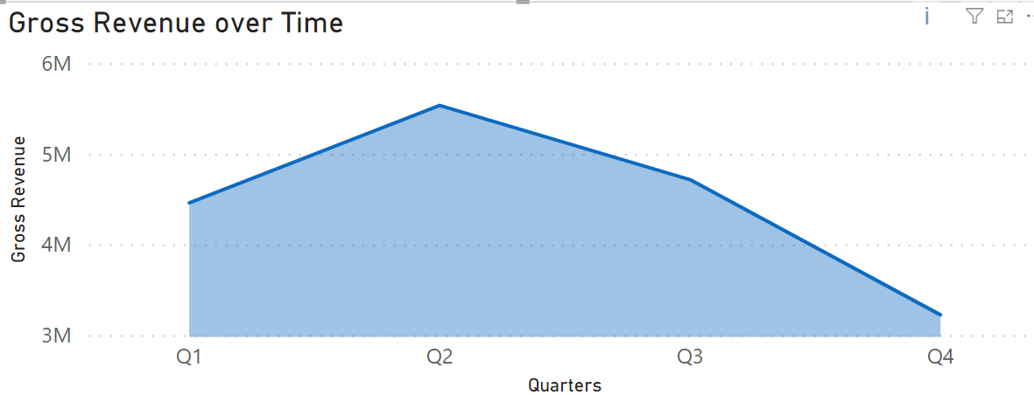
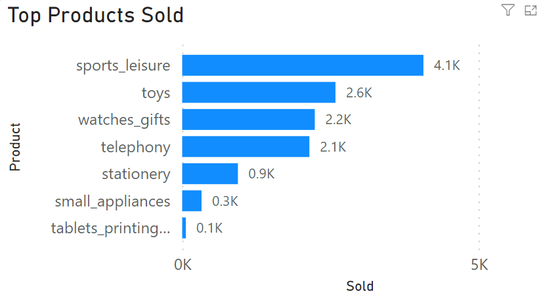
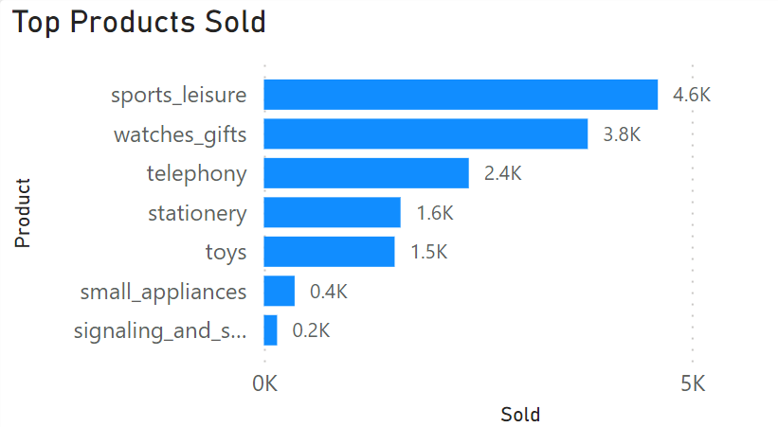
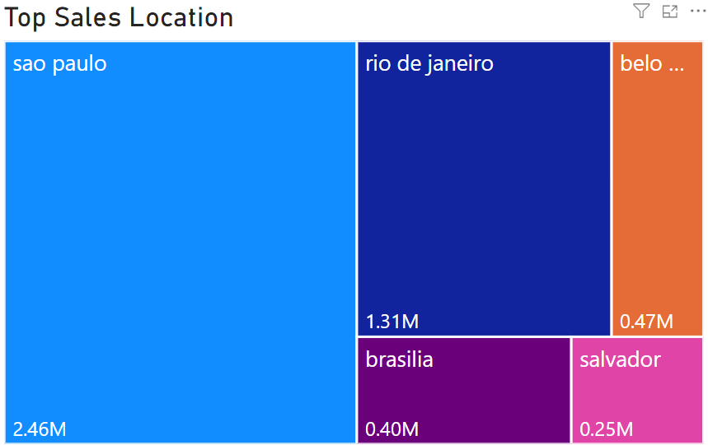
Analysis
2017
2018
Sales trend seasonality starts from Q1 with the highest in Q2 then slowly dying off in Q4
Changes in Top products sold from 2017 to 2018 to better the inventory operations behind the scenes
Top locations orders ship to also gives us insights to improve fulfillment services better in those areas

Slide 17
Business Process 4: Exchange & Returns
Problem statements:
Improving the E-commerce Return and Exchange Process to Enhance Customer Satisfaction and Profitability

Slide 18
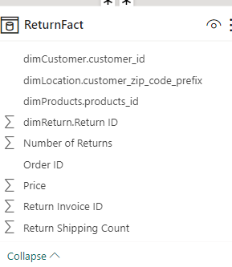
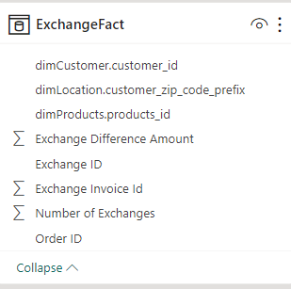
Understanding Our Dataset
Comprehensive dataset with transactional details.
Columns include Customer ID, Product ID, Price, Freight Value, and Return Status.
Insights into the return processing time, number of returns/exchanges, and associated costs.
Separate fact table for Return and exchange
Notes:
The dataset contains the following columns:
Customer ID: Unique identifier for the customer.
Product ID: Unique identifier for the product.
Price: Price of the product.
Freight Value: Cost of shipping the product.
Return Status: Indicates if the product was returned.
Return Processing Time: The time taken to process the return.
Number of Returns: The number of times a product was returned.
Number of Exchanges: The number of times a product was exchanged.
Return Shipping Count: The number of times the product was shipped back.
Exchange ID: Unique identifier for the exchange, if applicable.
Exchange Difference Amount: The price difference paid or refunded in case of an exchange.
Order ID: Unique identifier for the order.

Slide 19
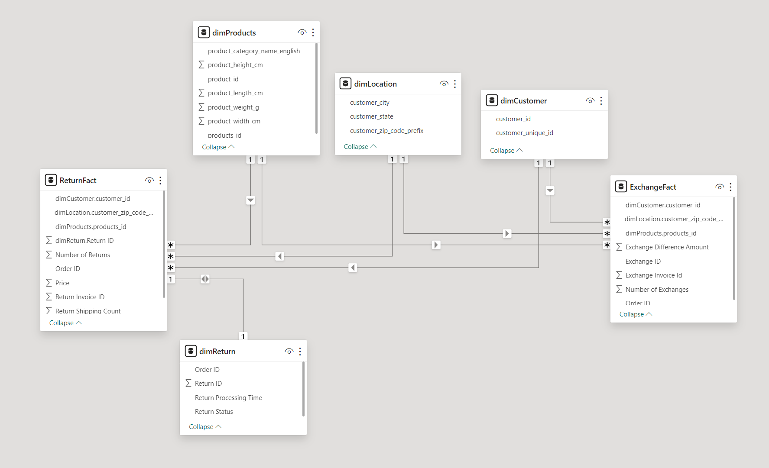
Data Model
Return Fact. Type: Transactional
Exchange Fact. Type: Transactional
Dimensions:
Products (Conformed)
Customer (Conformed)
Location (Conformed)
Return
Return Invoice ID(Degenerate Dim)
Exchange Invoice ID(Degenerate Dim)

Slide 20
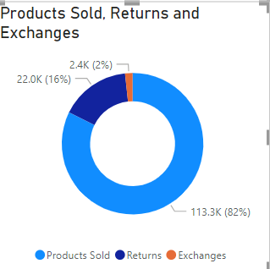
Sales,Return, and Exchange Proportion
Sales lead at 82%, returns at 16%, and exchanges at 2% of total transactions.
Highlighting strong sales performance with a focus on reducing returns.
Returns data suggest areas for product and service improvements.
Low exchanges indicate a potential to improve the exchange process.
Notes:
The chart illustrates the distribution of total transactions: 113.3K (82%) represent successful sales.
Returns are significant at 22K (16%), signaling a need for scrutiny into product satisfaction.
Exchanges are minimal at 2.4K (2%), indicating a lesser tendency for item replacement.
The stark contrast between sales and post-sale activities underscores the robustness of initial transactions.
The data prompts a strategic review of the returns process to identify underlying causes and implement preventative measures.
The low exchange rate suggests effective initial product matching, but also room for enhancing the exchange policy to be more customer-friendly.

Slide 21
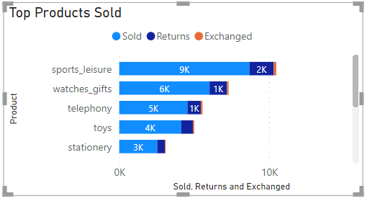
Category Performance and Enhancement Strategies
Insights:
High exchanges in sports_leisure .
Returns in watches_gifts and telephony.
Lesser returns in toys and stationery.
Actions:
Implement enhanced quality checks for top categories.
Improve online product representation.
Increase customer engagement for low-return categories
Notes:
Analysis:
Sports_leisure leads with 9K units sold but also faces 2K exchanges, indicating high engagement with potential for refinement.
Watches_gifts and telephony follow suit, with a noticeable ratio of returns, suggesting customer reassessment is necessary.
Toys and stationery have lower sales but proportionally fewer returns or exchanges.
Improvement Strategies:
Introduce targeted customer satisfaction surveys for the sports_leisure category to identify specific reasons for exchanges.
Review and enhance product descriptions and images for watches_gifts and telephony to reduce returns.
Implement a customer feedback loop for the toys and stationery categories to improve product selection and match customer expectations.

Slide 22
Business Process 5: Customer Review & Feedback
Objective/Problem statements:
Improve Services: Analyze customer feedback to pinpoint areas for service enhancement.
Understand Trends: Use feedback data to spot trends and adapt business strategies accordingly.

Slide 23
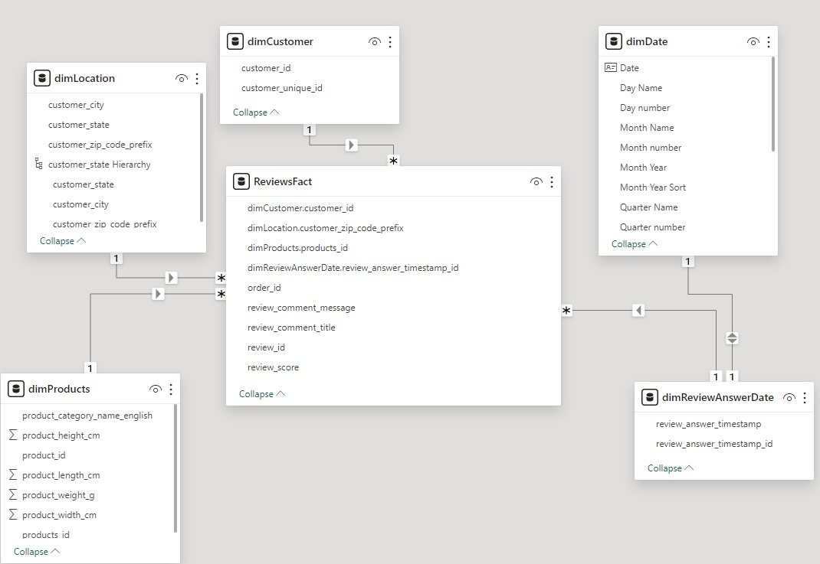
Data Model
Fact Table. Type: Transactional
Review id : Degenerative Dimention
Dimensions:
Products (Conformed)
Customer (Conformed)
Location (Conformed)
Review Answer Date (Role-Playing)

Slide 24
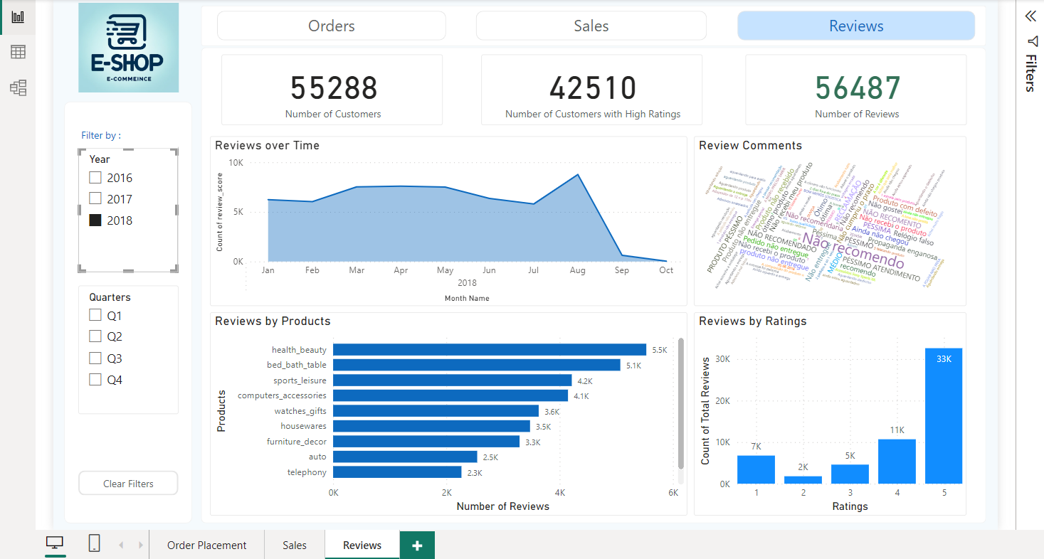
Analysis and Outcomes/Learnings
Overall

Slide 25
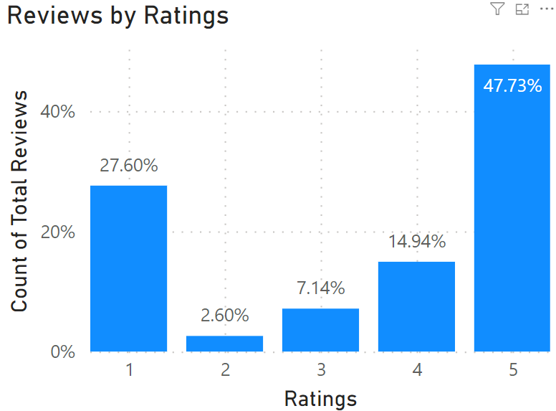
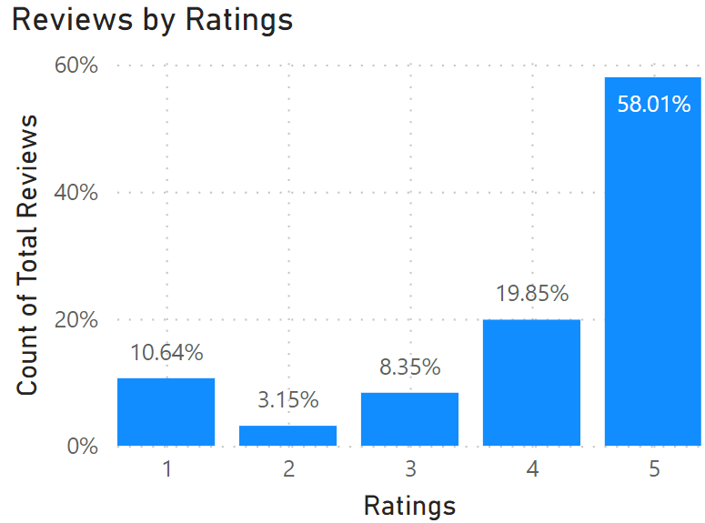
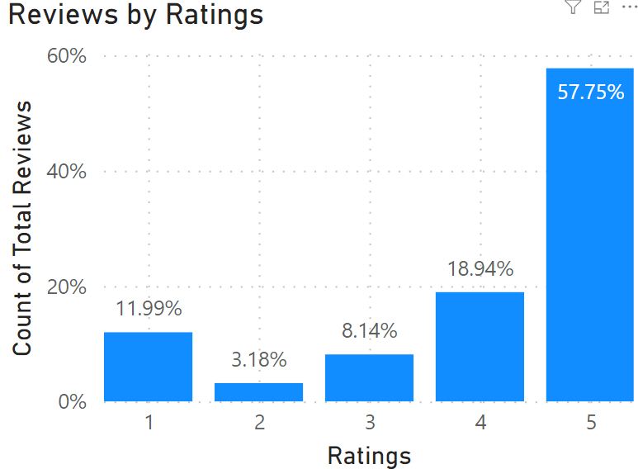
Analysis and Outcomes/Learnings
There was a significant rise in 5-star ratings from 2016 to 2017, showing an improvement in customer satisfaction during that period.
While the percentage of 5-star ratings in 2018 remains higher than in 2016, there's a slight drop compared to 2017, indicating the need to investigate potential causes and address any emerging issues.
The decrease in 1-star and 2-star ratings from 2016 to 2018 suggests effective resolutions to previous customer concerns, but the dip in top ratings in 2018 calls for a review of recent changes or market conditions that may have influenced customer perceptions.
Year
2016
2017
2018

Slide 26
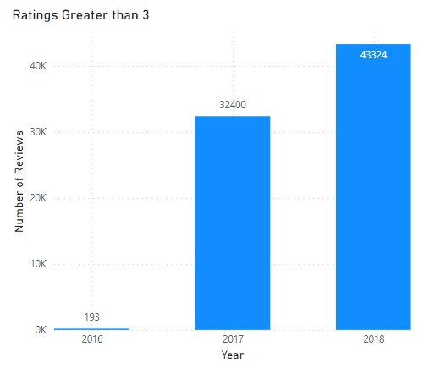
Analysis and Outcomes/Learnings
From 2016 to 2018, the number of good reviews really went up. There were only 193 in 2016, but by 2018, there were 43,324!

Slide 27
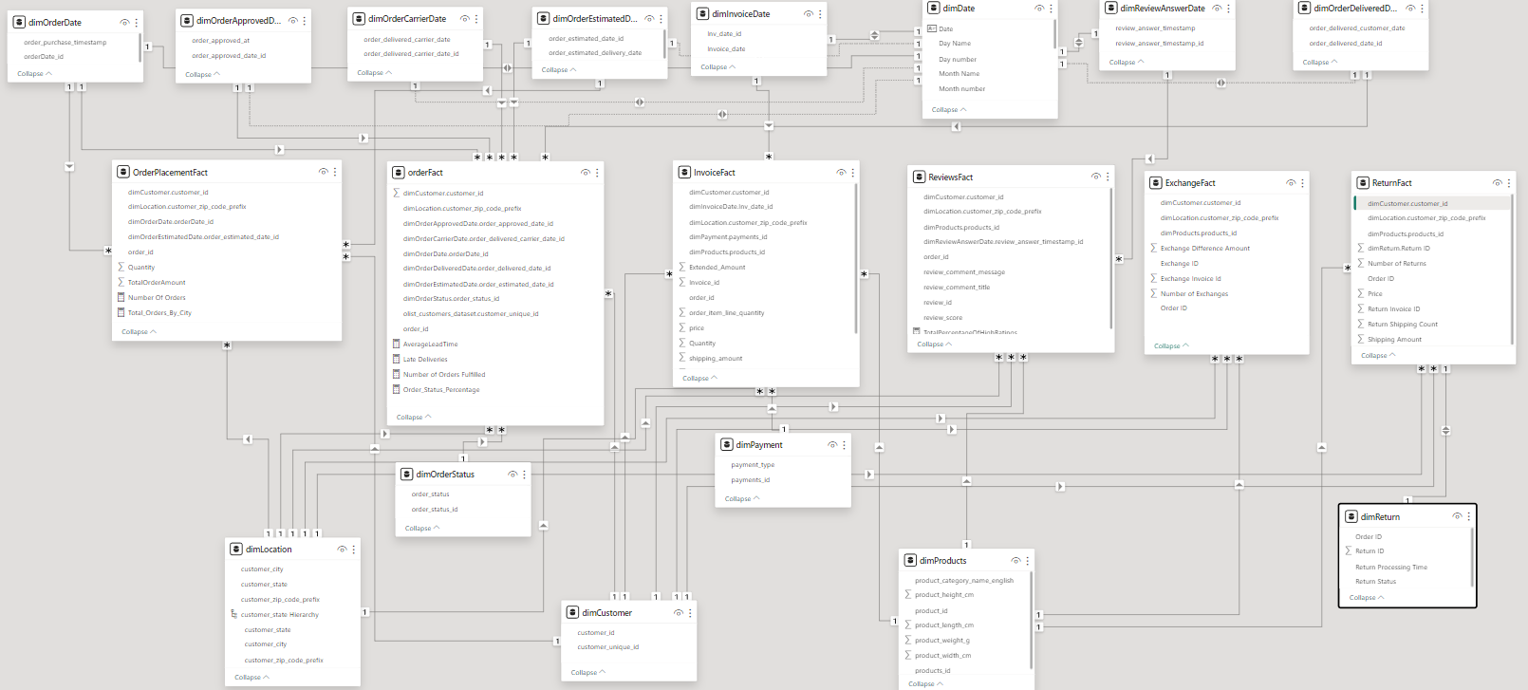
Final Combined Model

Slide 28
Best Practices
Naming Conventions should be agreed upon initially and should be same across the model.
Use surrogate keys whenever possible. Model performance is greatly improved when data size increases.
Disable load for the tables from which are not being used.

Slide 29
Thank you

